Slide 1

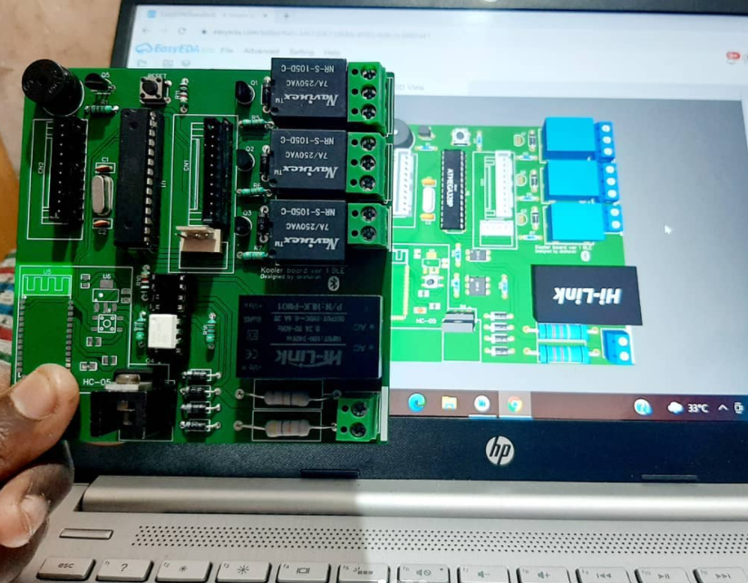
Home automation using Atmega328p with Bluetooth Protocol
Presented By:-
Siddhesh Naik
Seat No 2017179
Department Of Physics
KJSSC

Slide 2
Introduction
In today’s age of Information technology we are moving more towards making things wireless and home automation is one of the most promising application of wireless technology.
This paper reveals us the use of Bluetooth protocol to automate our household appliances wirelessly
After studying this paper we can design a low cost, reliable and scalable home automation system

Slide 3
Specifications
Uses ATmega328p chip inform of an Arduino Board as the main microcontroller
HC-05 Bluetooth module to establish a wireless communication between the smartphone and the microcontroller
Software is written in C++ using Arduino IDE
A Bluetooth terminal application is used to send command to HC-05 module.

Slide 4

Hardware Architecture
Atmega328p microcontroller in form of an Arduino Board
-Uses Atmega328p MuC
-Has inbuilt Crystal Oscillator,
USB Voltage regulator, reset
button, 3.3V and 5V Voltage
regulator, Female GPIO
header pins.

Slide 5
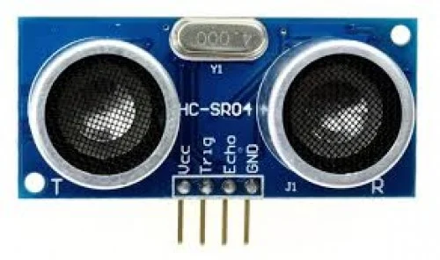
Ultrasonic sensor HC-SR04
-It uses a 40Khz Ultrasound transducer to produce a sound wave and by calculating the time taken for wave to get back to the receiver upon refection we get the distance from the object.
-MuC gives a pulse to Trig pin and measures the time taken for the pulse to appear at Echo pin ,thus taking the speed of sound we get the distance from the object to our sensor. Vcc and Gnd are for powering the module.

Slide 6
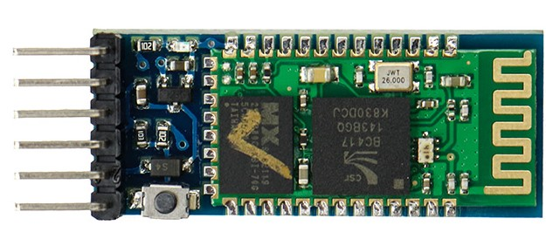
HC-05 Bluetooth Module
HC 05 has TX and RX pins that will transmit and receive through UART protocol. This module will receive data through Bluetooth protocol and will communicate with the MuC through UART

Slide 7
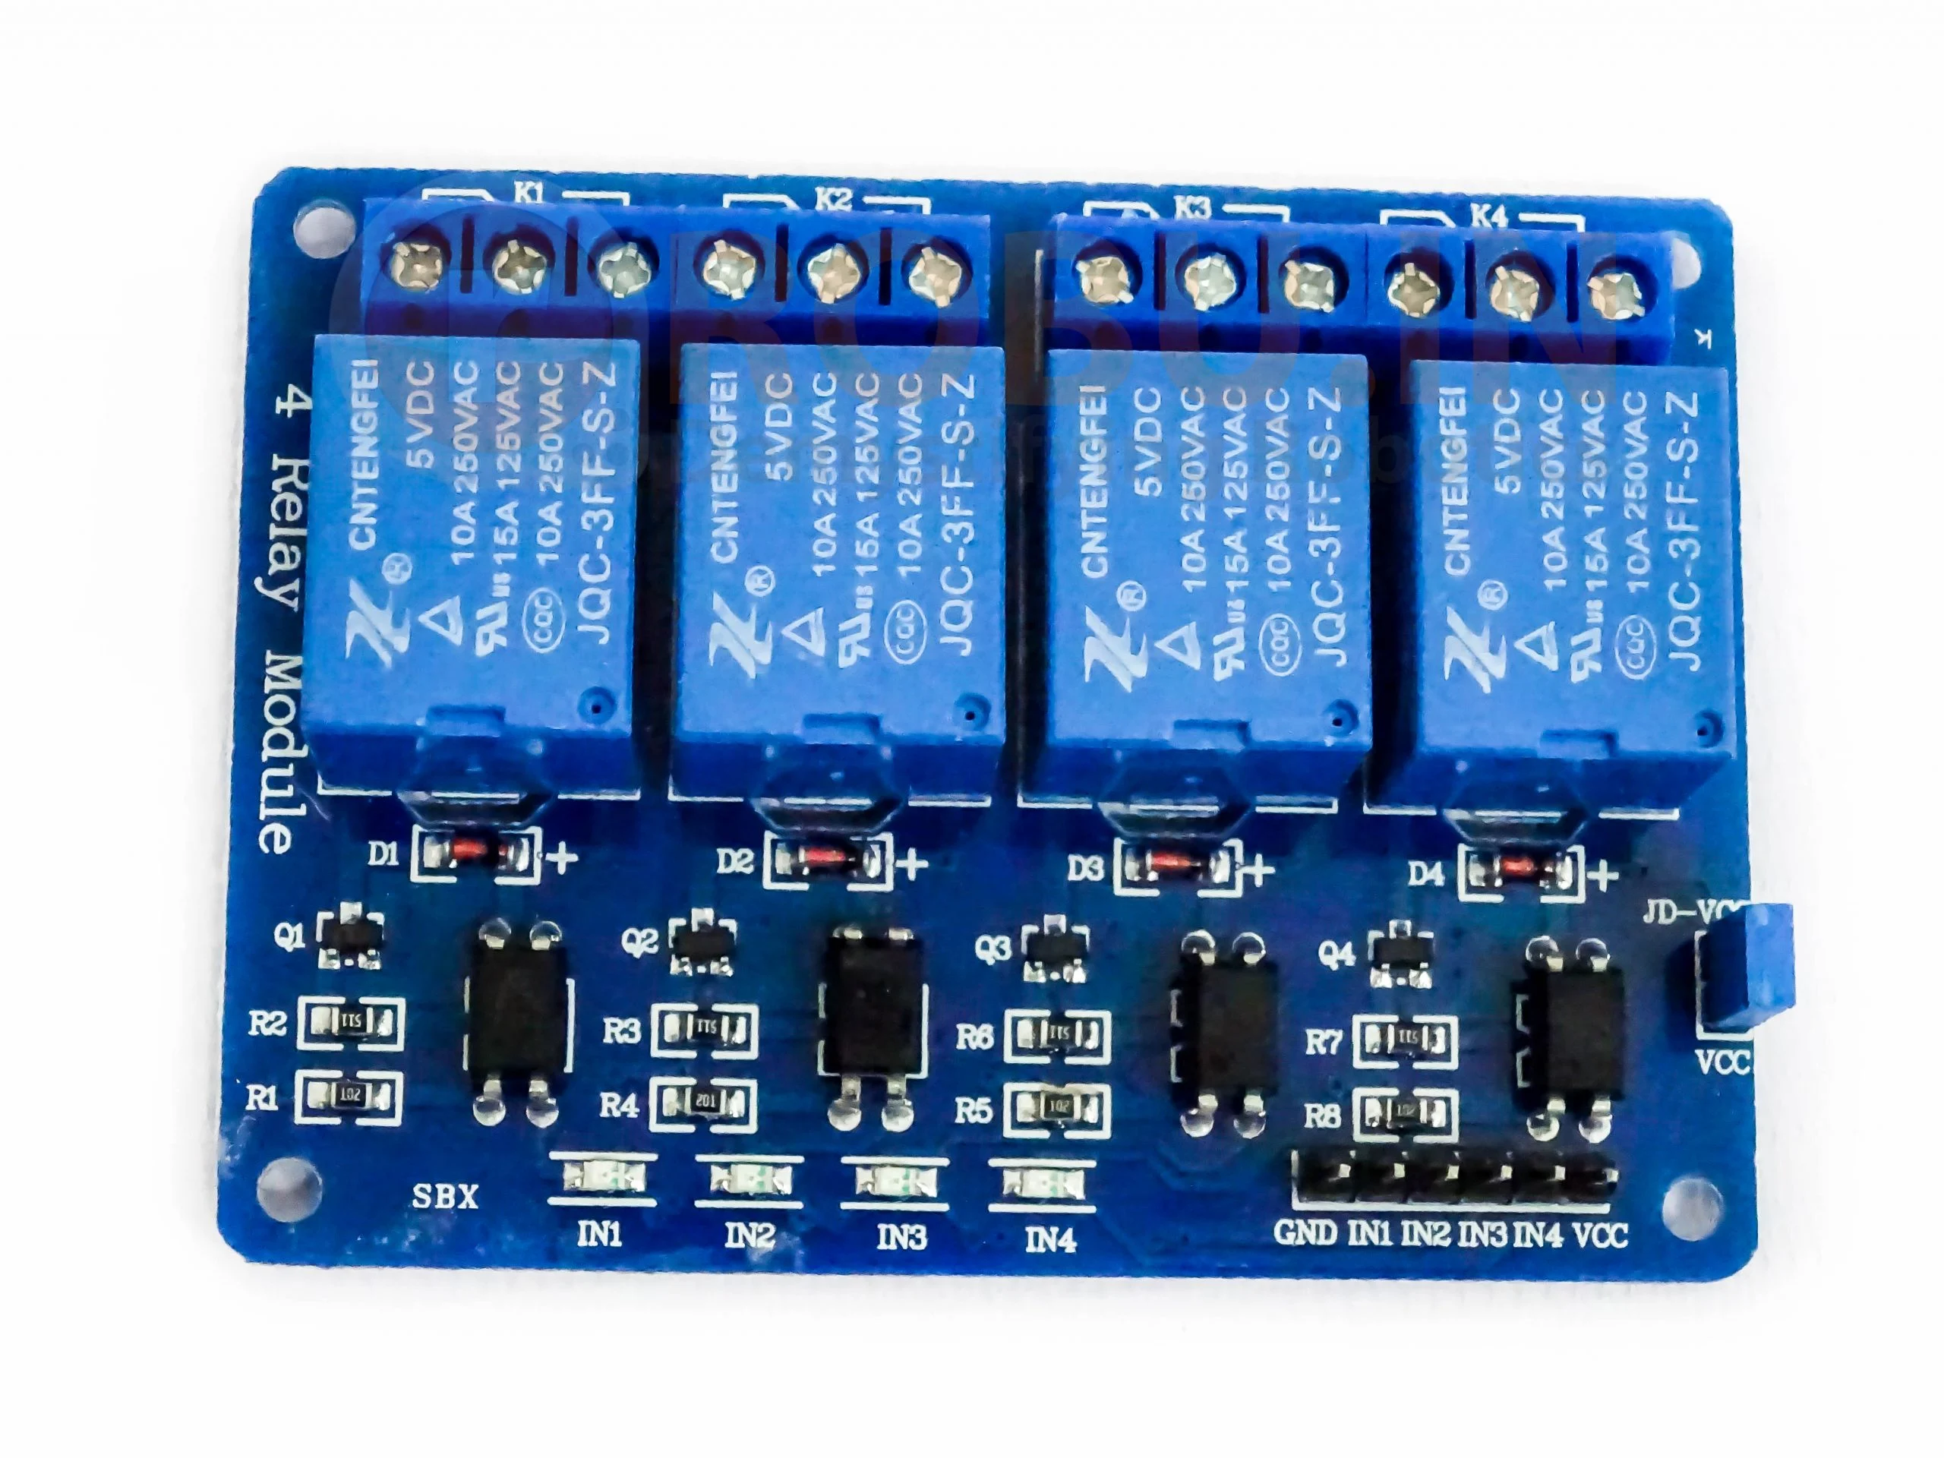
4 Channel Relay board
-It has 4 electromechanical relay and their inputs are driven by optocouplers
-Each relay has NO(Normally open), NC(Normally Connected), COM(Common terminal)
-It can be driven by both 12V and 5V

Slide 8
Software Architecture

